Slide 1




NEXT GEN EMPLOYABILITY PROGRAM
Creating a future-ready workforce
Team Members
College Name
Student Name :VIGNESHWARAN.S
Student ID :822621104308
ARIFA INSTITUTE OF TECHNOLOGY

Slide 2

CAPSTONE PROJECT SHOWCASE
Project Title
VOTING WEB APPLICATION USING DJANGO FRAMEWORK
Abstract | Problem Statement | Project Overview | Proposed Solution | Technology Used | Modelling & Results | Conclusion

Slide 3
Abstract 1. Purpose:DevelopingDjango-based web app for secure online voting. 2.Features: User-friendly interface, candidate nomination, secure ballot casting. 3. Security: Implementation of encryption, authentication, and authorization mechanisms. 4. Scalability: Designed to handle varying election sizes and user loads. 5. Impact: Enhancing democratic processes through accessible and transparent voting.
Source :

Slide 4
Problem Statement
Problem Statement: Developing a secure and scalable voting web application using Django framework.
Challenges:
1.Implementing robust authentication and authorization mechanisms.
2.Designing an intuitive user interface for easy navigation.
3.Handling large volumes of concurrent users efficiently.
4.Ensuring the integrity and confidentiality of the voting process.
Source :

Slide 5
Project Overview 1.ABSTRACT 2.PROBLEM STATEMENT 3.PROPOSED SOLUTION 4.TECHNOLOGY USED 5.MODELING AND RESULTS 6. FUTURE ENHANCEMENT 7.CONCULISON
Source :

Slide 6
Proposed Solution
1.Creating Views: Write views to handle user requests, such as displaying the list of candidates, allowing users to vote
2.Setting up Django: Install Django and create a new project using django-admin startproject project_name.
Source :

Slide 7
3..Templates: Design HTML templates to render the views with appropriate forms and content.
4..URLs: Define URL patterns to map URLs to the appropriate views.Business Logic:
5..Implement the logic for vote counting and ensuring each user can only vote once.
Source :

Slide 8
6..Authentication and Authorization: Implement user authentication to ensure only registered users can vote.
7..Testing: Thoroughly test the application to ensure it functions correctly and securely.
8.. such as protecting against CSRF attacks, validating user input, and securely storing passwords. Django provides built-in tools and libraries to help with these tasks.
Source :

Slide 9


Technology Used
Front-end
Back-end
Source :

Slide 10
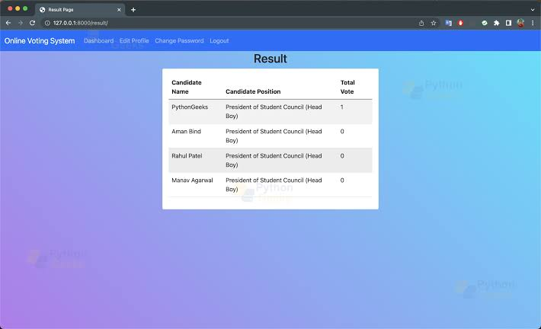
Modelling & Results
Source :

Slide 11
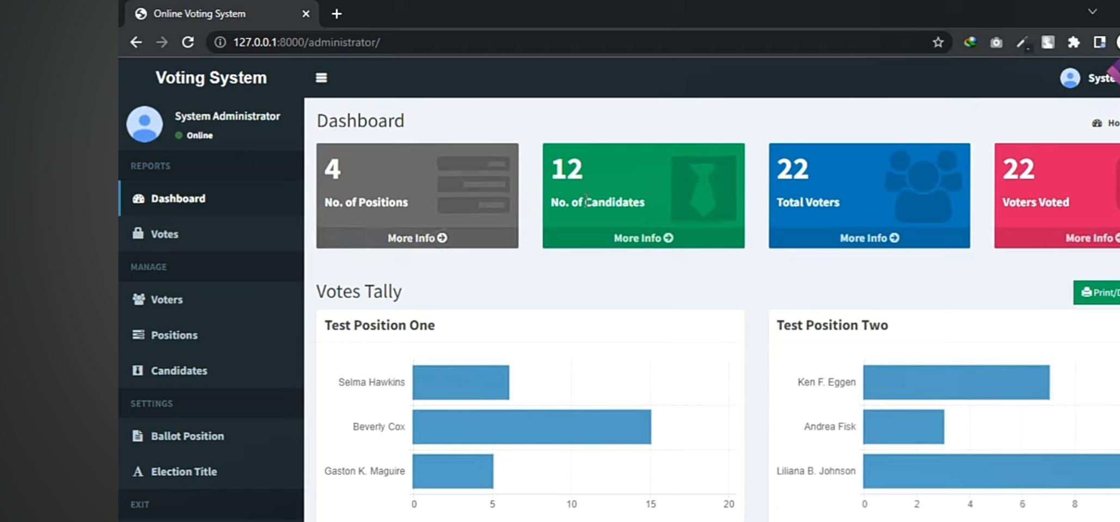
Homepage

Slide 12
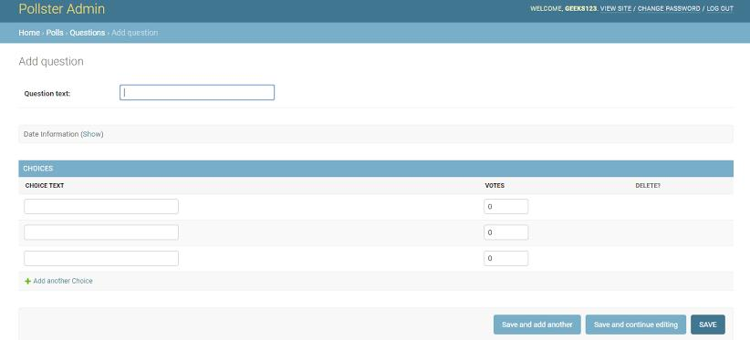
About-Us-Page

Slide 13
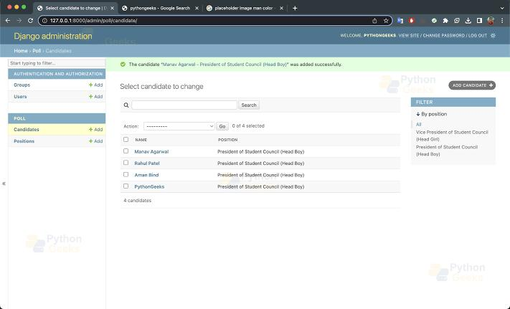
Service-Page

Slide 14
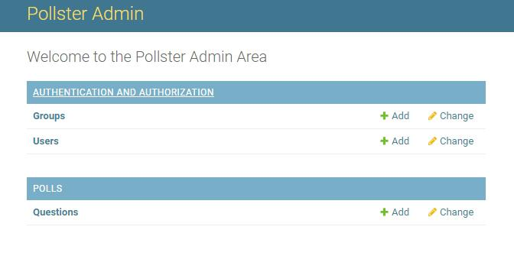
Departments-Page

Slide 15
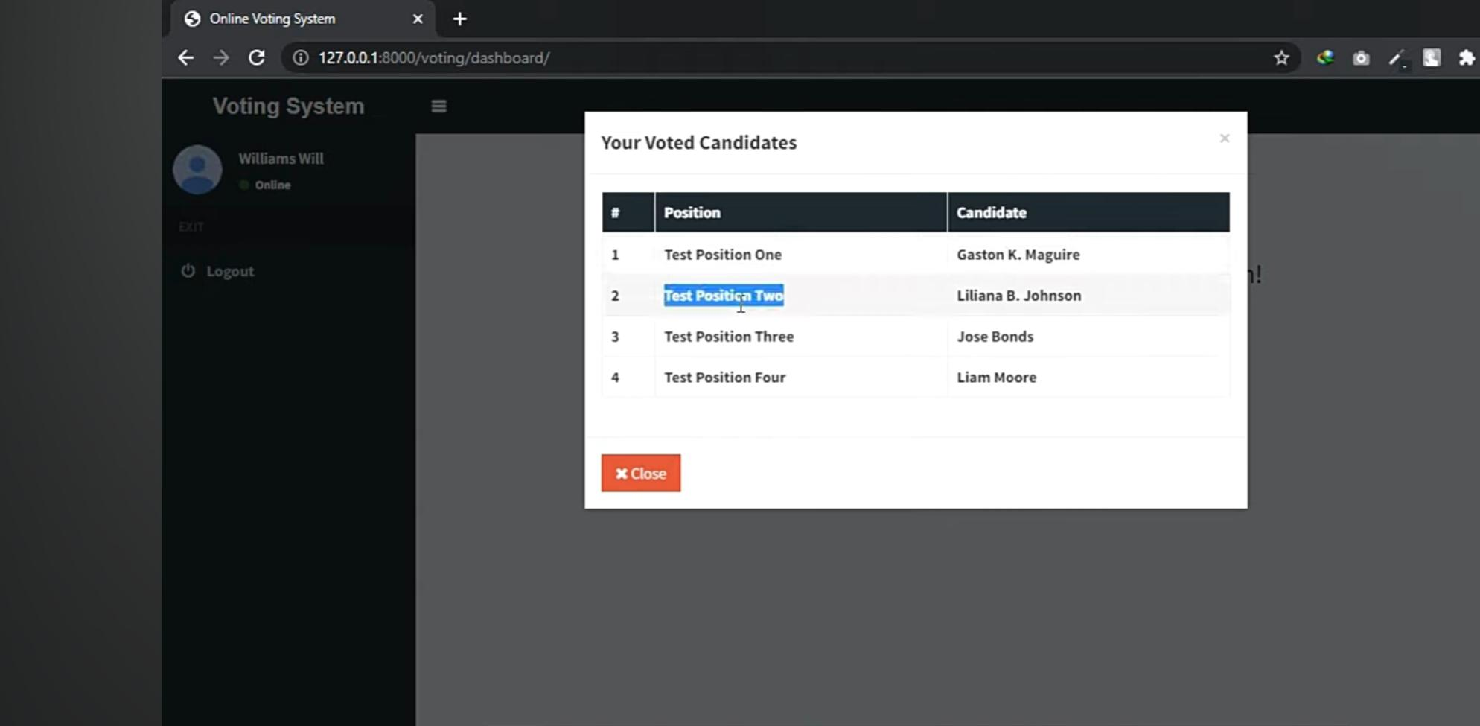
Blog-Page

Slide 16
Future Enhancements:
Real-time Updates: Implement real-time updates for poll results using technologies like WebSockets to provide users with instant feedback on voting outcomes.
Enhanced Security Measures: Integrate additional security measures such as two-factor authentication (2FA) and encrypted communication channels to further safeguard user data and prevent unauthorized access.
User Feedback Mechanisms: Implement user feedback mechanisms to gather input on the voting experience and identify areas for improvement. This could include surveys, ratings, or comment sections for each poll.

Slide 17
Conclusion
In conclusion, the development of a voting web application using the Django framework offers a robust and scalable solution for conducting secure and efficient voting processes. Through the implementation of advanced features and best practices, such as secure authentication, real-time result updates, and user-friendly interfaces, the application provides a reliable platform for users to participate in polls and surveys.By addressing challenges such as data integrity, scalability, and security, the Django framework enables the creation of a voting system that ensures the confidentiality and integrity of the voting process while handling large volumes of concurrent users with ease.As technology continues to evolve, future enhancements such as real-time updates, enhanced security measures, integration with external systems, user feedback mechanisms, and gamification features promise to further elevate the voting experience and drive user engagement.In essence, the voting web application developed with Django not only meets the immediate needs of organizations, communities, and businesses but also lays the foundation for continuous improvement and innovation in the realm of online voting.
Source :

Slide 18
Thank You!
Notes:
Thank You !!

